Slide 1
Unsupervised Learning

Slide 2
Unsupervised Learning
Unsupervised learning is a branch of machine learning that deals with unlabeled data.
Task of unsupervised learning algorithms to find patterns and relationships within the data without any prior knowledge of the data’s meaning.
It is powerful tool for exploratory data analysis, where the goal is to understand the underlying structure of the data.

Slide 3
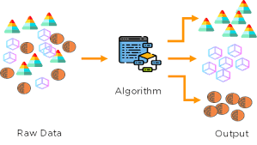

Slide 4
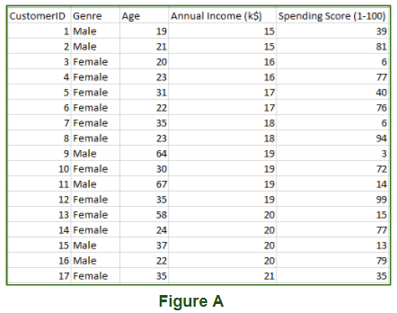

Slide 5
Types of Unsupervised Learning
Clustering: Grouping similar data points into clusters based on their inherent characteristics or features.
K-means, hierarchical clustering, and DBSCAN are common clustering algorithms.
Association: Discovering relationships or associations between variables in a dataset.
Apriori and FP-growth are algorithms used for association rule learning.
Dimensionality Reduction: Reducing the number of features or variables in the dataset while preserving its key information.
Principal Component Analysis (PCA) and t-distributed Stochastic Neighbor Embedding (t-SNE) are examples of dimensionality reduction techniques.

Slide 6
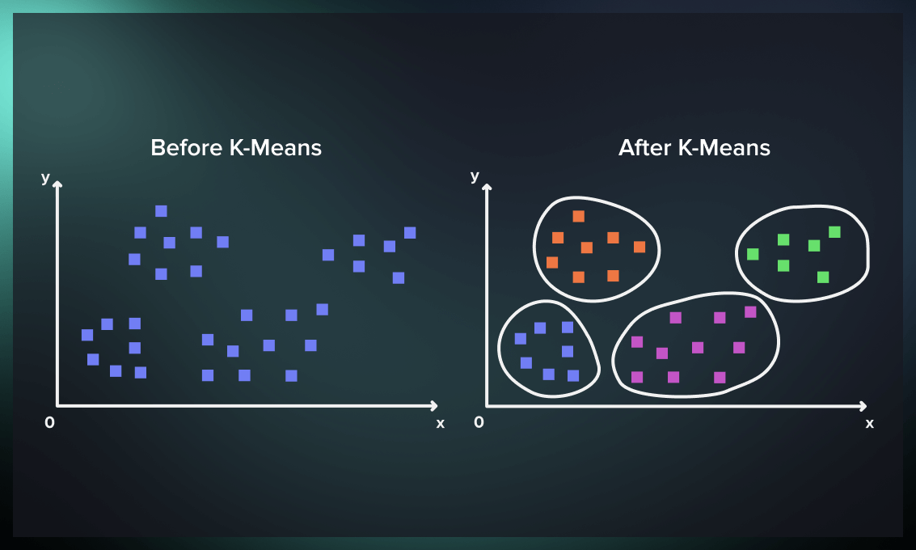
Clustering

Slide 7
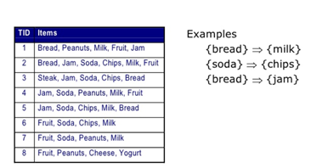
Association Rule Mining

Slide 8
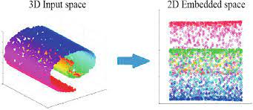
Dimensionality Reduction

Slide 9
Applications
Clustering applications
Customer segmentation in marketing.
Image segmentation in computer vision.
Anomaly detection in cybersecurity.
News Segmentation
Association Applications
Market Basket Analysis: Understanding purchasing behavior to recommend related products or optimize store layouts.
Promotion Planning: Identifying product combinations for effective promotions or bundling strategies.

Slide 10
Applications
Dimensionality Reduction Applications
Feature extraction in image and signal processing.
Visualization of high-dimensional data for better understanding.

Slide 11
Unsupervised Machine Learning
Advantages:
No need for labeled data, which can be expensive or time-consuming to obtain.
Helps in exploratory data analysis and identifying hidden structures within the data.
Enables handling of large and complex datasets for pattern discovery.
Challenges:
Interpretability of results can be challenging.
Evaluation metrics may not always be straightforward in unsupervised learning compared to supervised learning.

Slide 12
Quiz
In the following examples, which would you address using an unsupervised learning algorithm?
Given a set of news articles found on the web, group them into sets of articles about the same stories.
Given email labeled as spam/not spam, learn a spam filter.
Given a database of customer data, automatically discover market segments and group customers into different market segments.
Given a dataset of patients diagnosed as either having diabetes or not, learn to classify new patients as having diabetes or not.

Slide 13
Clustering
Clustering or cluster analysis is a machine learning technique, which groups the unlabelled dataset.
It can be defined as "A way of grouping the data points into different clusters, consisting of similar data points. The objects with the possible similarities remain in a group that has less or no similarities with another group."

Slide 14
Types of Clustering
Hard Clustering: Each data point belongs to a cluster completely or not. For example, Let’s say there are 4 data point and we have to cluster them into 2 clusters. So each data point will either belong to cluster 1 or cluster 2.
Soft Clustering: In this type of clustering, instead of assigning each data point into a separate cluster, a probability or likelihood of that point being that cluster is evaluated.

Slide 15
Data Points | Clusters
A | C1
B | C2
C | C2
D | C1
Data Points | Probability of C1 | Probability of C2
A | 0.91 | 0.09
B | 0.3 | 0.7
C | 0.17 | 0.83
D | 1 | 0

Slide 16
Types of Clustering Algorithms
Centroid-based Clustering (Partitioning methods)
Density-based Clustering (Model-based methods)
Connectivity-based Clustering (Hierarchical clustering)
Distribution-based Clustering

Slide 17
Centroid-based Clustering
Centroid-based clustering is a machine learning technique that partitions a dataset into groups of similar data points, known as clusters.
This technique uses centroids, the center of each cluster, to minimize the sum of the distances between the data points and their corresponding cluster centroids.
As a result, the data points are as close as possible to the center of the cluster and the inter-cluster distance is maximized.

Slide 18
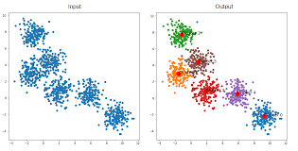
Centroid-based Clustering

Slide 19
K means algorithm
K means algorithm is one of the centroid based clustering algorithms.
K is the number of clusters and is a hyperparameter to the algorithm.
The core idea behind the algorithm is to find k centroids followed by finding k sets of points which are grouped such that the squared distances of the points in the cluster to the centroid are minimized.

Slide 20
K means algorithm
Step-1: Select the number K to decide the number of clusters.
Step-2: Select random K points or centroids. (It can be other from the input dataset).
Step-3: Assign each data point to their closest centroid, which will form the predefined K clusters.
Step-4: Calculate the variance and place a new centroid of each cluster.
Step-5: Repeat the third steps, which means reassign each datapoint to the new closest centroid of each cluster.
Step-6: If any reassignment occurs, then go to step-4 else go to FINISH.
Step-7: The model is ready.

Slide 21
K means algorithm
Object | F1 | F2
O1 | 1 | 3
O2 | 2 | 2
O3 | 5 | 8
O4 | 8 | 5
O5 | 3 | 9
O6 | 10 | 7
O7 | 3 | 3
O8 | 9 | 4
P9 | 3 | 7

Slide 22
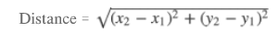
K means algorithm
Data Points: P1(1,3) , P2(2,2) , P3(5,8) , P4(8,5) , P5(3,9) , P6(10,7) , P7(3,3) , P8(9,4) , P9(3,7).
First, we take our K value as 3 and we assume that our Initial cluster centers are P7(3,3), P9(3,7), P8(9,4) as C1, C2, C3.
Find the distance between data points and Centroids. which data points have a minimum distance that points moved to the nearest cluster centroid.

Slide 23
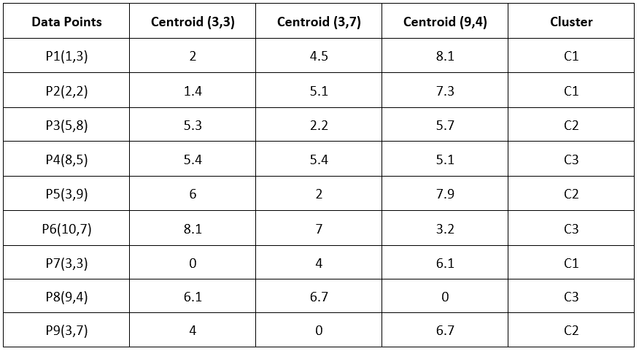
K means algorithm
Iteration 1
Calculate the distance between data points and K (C1,C2,C3)

Slide 24
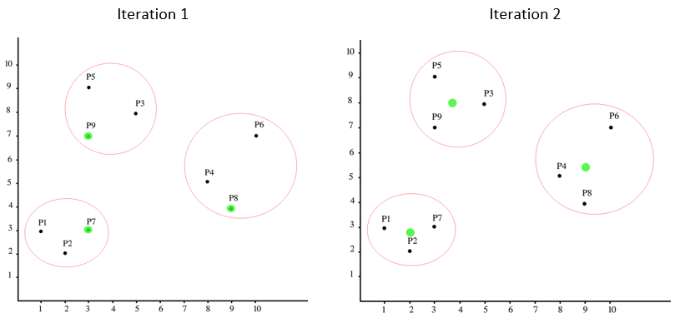
K means algorithm
Iteration 1
Calculate the distance between data points and K (C1,C2,C3)

Slide 25
K means algorithm
Now, re-compute the new clusters and the new cluster center is computed by taking the mean of all the points contained in that particular cluster.
New center of Cluster 1 => (1+2+3)/3 , (3+2+3)/3 => 2,2.7
New center of Cluster 2 => (5+3+3)/3 , (8+9+7)/3 => 3.7,8
New center of Cluster 3 => (8+10+9)/3 , (5+7+4)/3 => 9,5.3

Slide 26
K means algorithm
Iteration 2
Calcualte the distance between data points and K (C1,C2,C3)
C1(2,2.7) , C2(3.7,8) , C3(9,5.3)

Slide 27
K means algorithm
Iteration 2
Calculate the distance between data points and New K (C1,C2,C3)

Slide 28
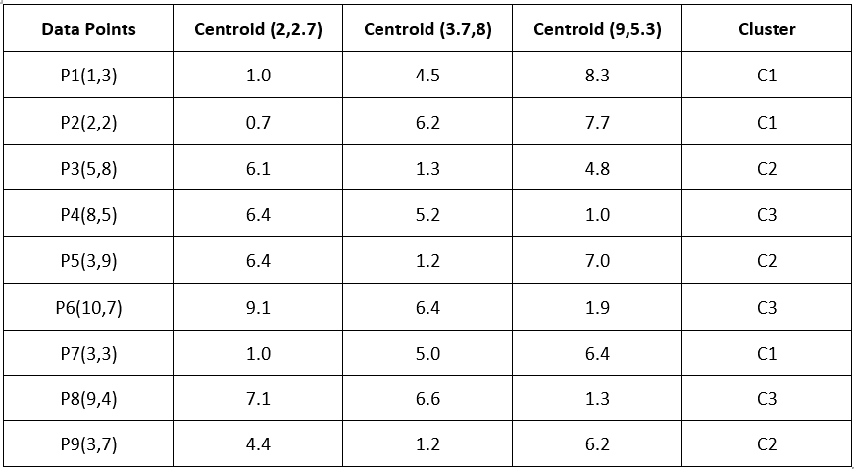
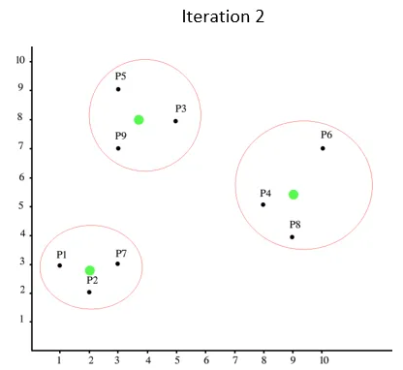
K means algorithm

Slide 29
K means algorithm
Compute
New Center of Cluster 1 => (1+2+3)/3 , (3+2+3)/3 => 2,2.7
New Center of Cluster 2 => (5+3+3)/3 , (8+9+7)/3 => 3.7,8
New Center of Cluster 3 => (8+10+9)/3 , (5+7+4)/3 => 9,5.3
We got the same centroid and cluster groups, stops iteration.

Slide 30
Elbow Method for optimal value of k in KMeans
Choose a range of k values: Start by selecting a range of possible values for k. Typically, you would choose a range of k values based on your domain knowledge or by experimenting with different values. For example, you might try k values from 1 to 10 initially.
Run KMeans: Apply the KMeans algorithm to your dataset for each value of k in the chosen range. Each run of KMeans will produce a clustering of the data into k clusters.
Compute the sum of squared distances (SSD) for each k: For each value of k, calculate the sum of squared distances (SSD) of each data point to its corresponding centroid. This is also referred to as the within-cluster sum of squares (WCSS).
Plot the Elbow Curve: Plot a line chart with k on the x-axis and the corresponding SSD or WCSS on the y-axis. This plot will typically show a decreasing trend in the SSD as k increases (since adding more clusters should reduce the distances), but the rate of decrease will slow down as k increases.
Identify the "elbow" point: Look for the point on the plot where the rate of decrease in SSD slows down significantly. This point is called the "elbow" point. Intuitively, it represents the value of k where adding more clusters ceases to provide a significant improvement in clustering quality.

Slide 31
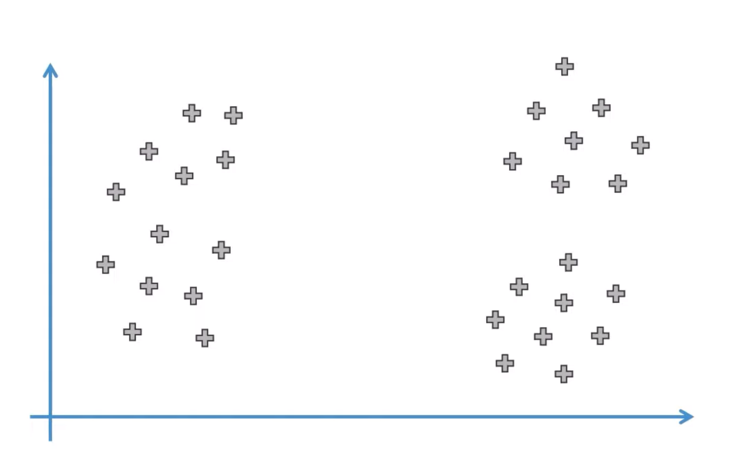
Elbow Method for optimal value of k in KMeans

Slide 32
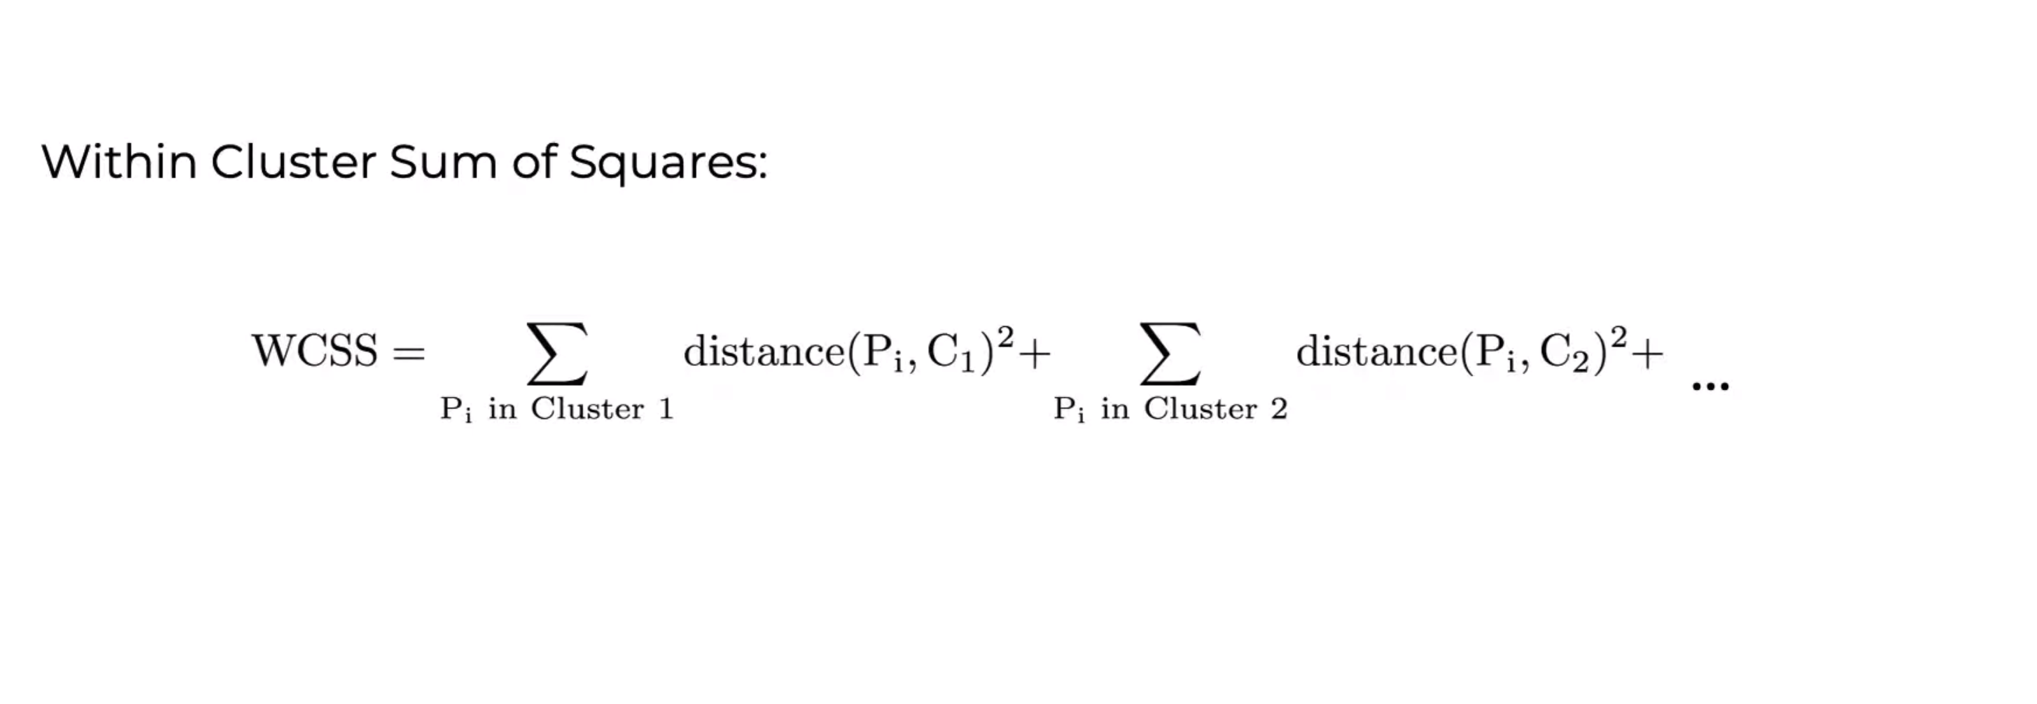
Elbow Method for optimal value of k in KMeans

Slide 33
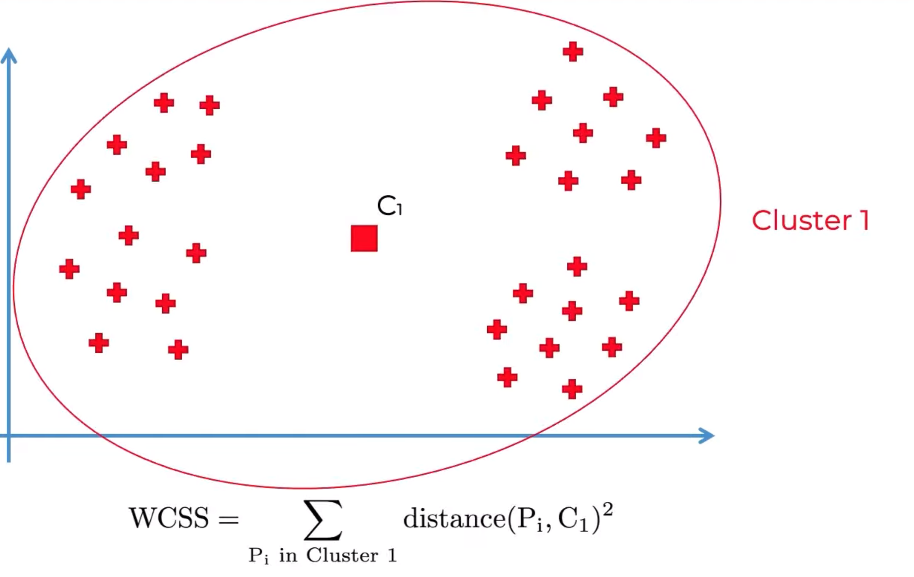
Elbow Method for optimal value of k in KMeans

Slide 34
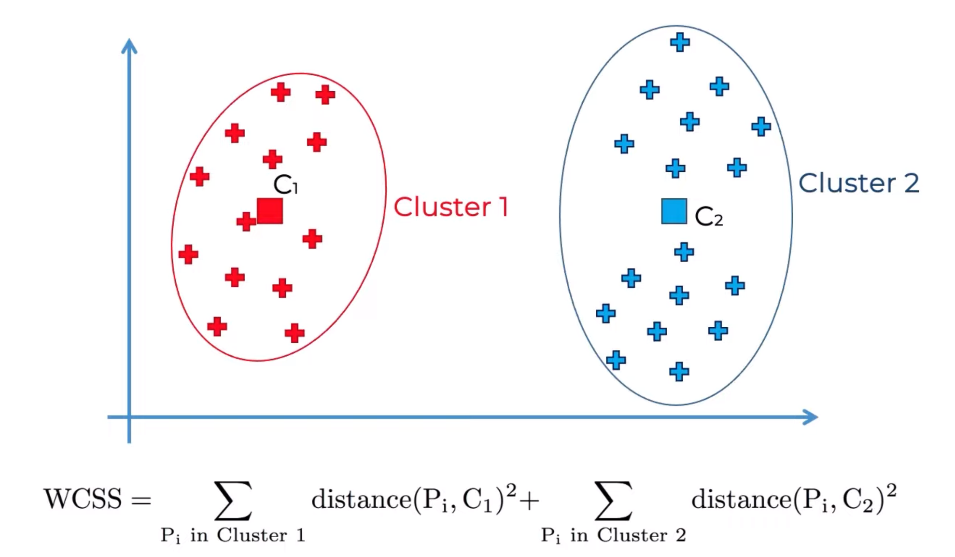
Elbow Method for optimal value of k in KMeans

Slide 35
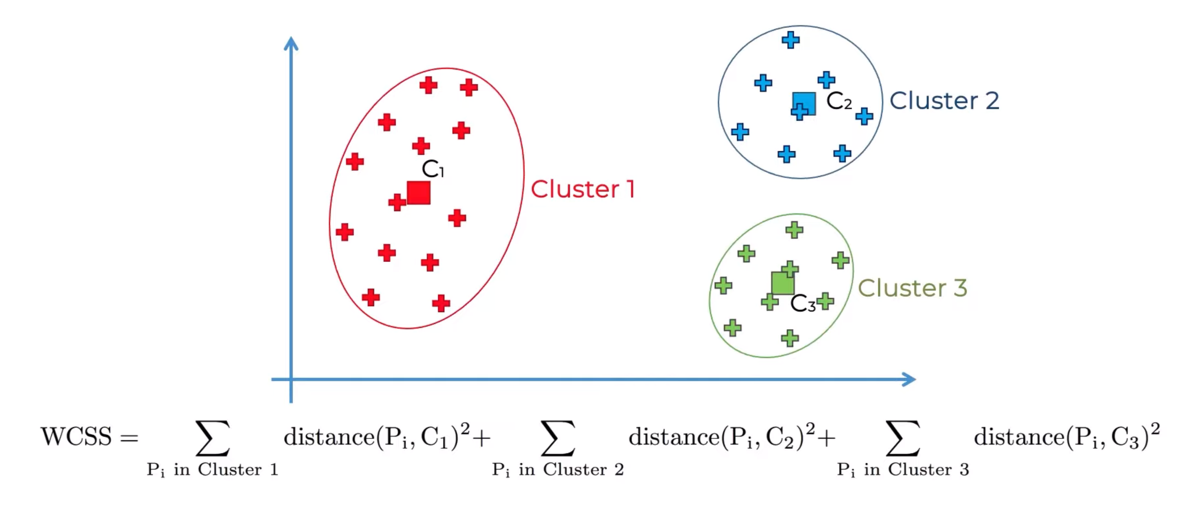
Elbow Method for optimal value of k in KMeans

Slide 36
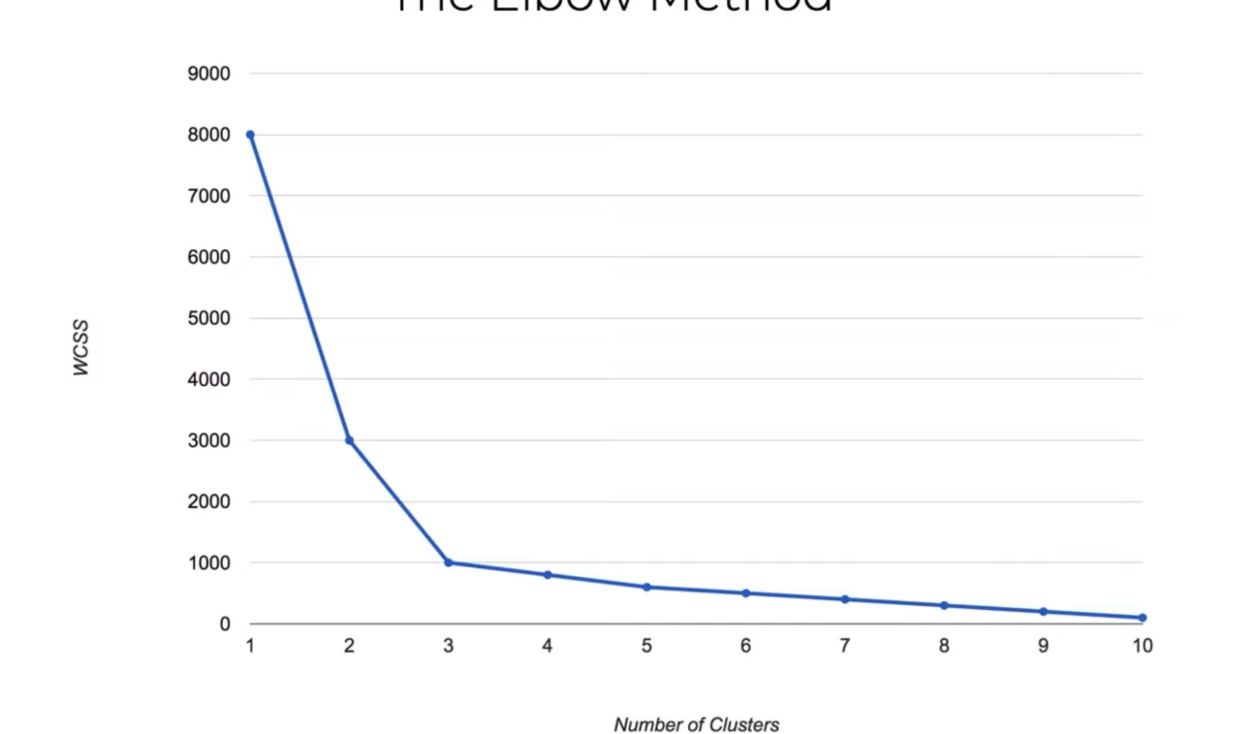
Elbow Method for optimal value of k in KMeans

Slide 37
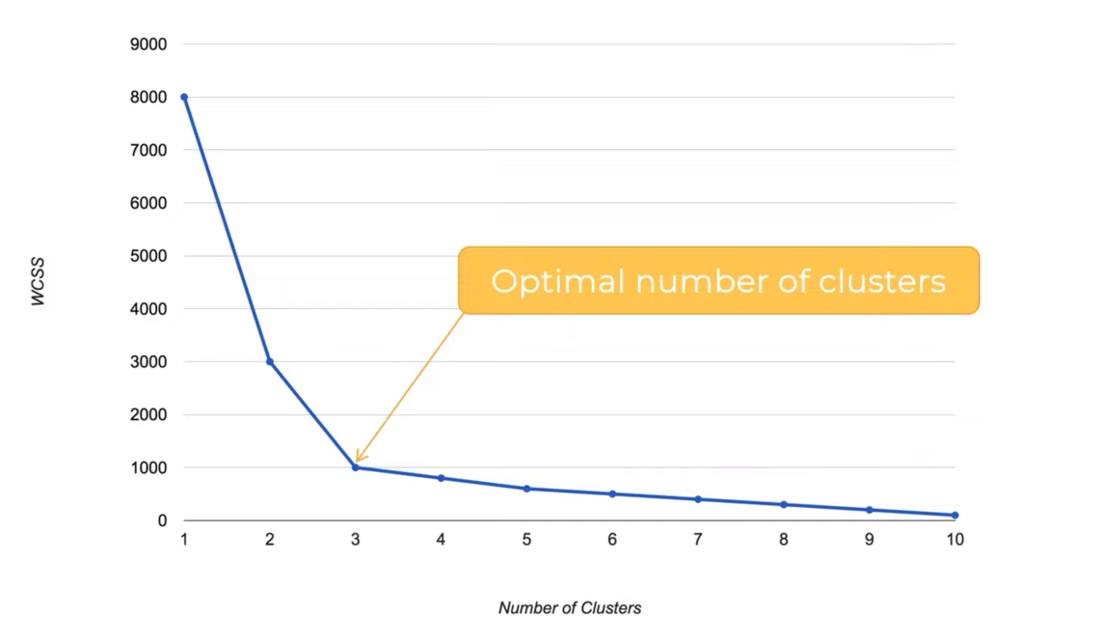
Elbow Method for optimal value of k in KMeans

Slide 38
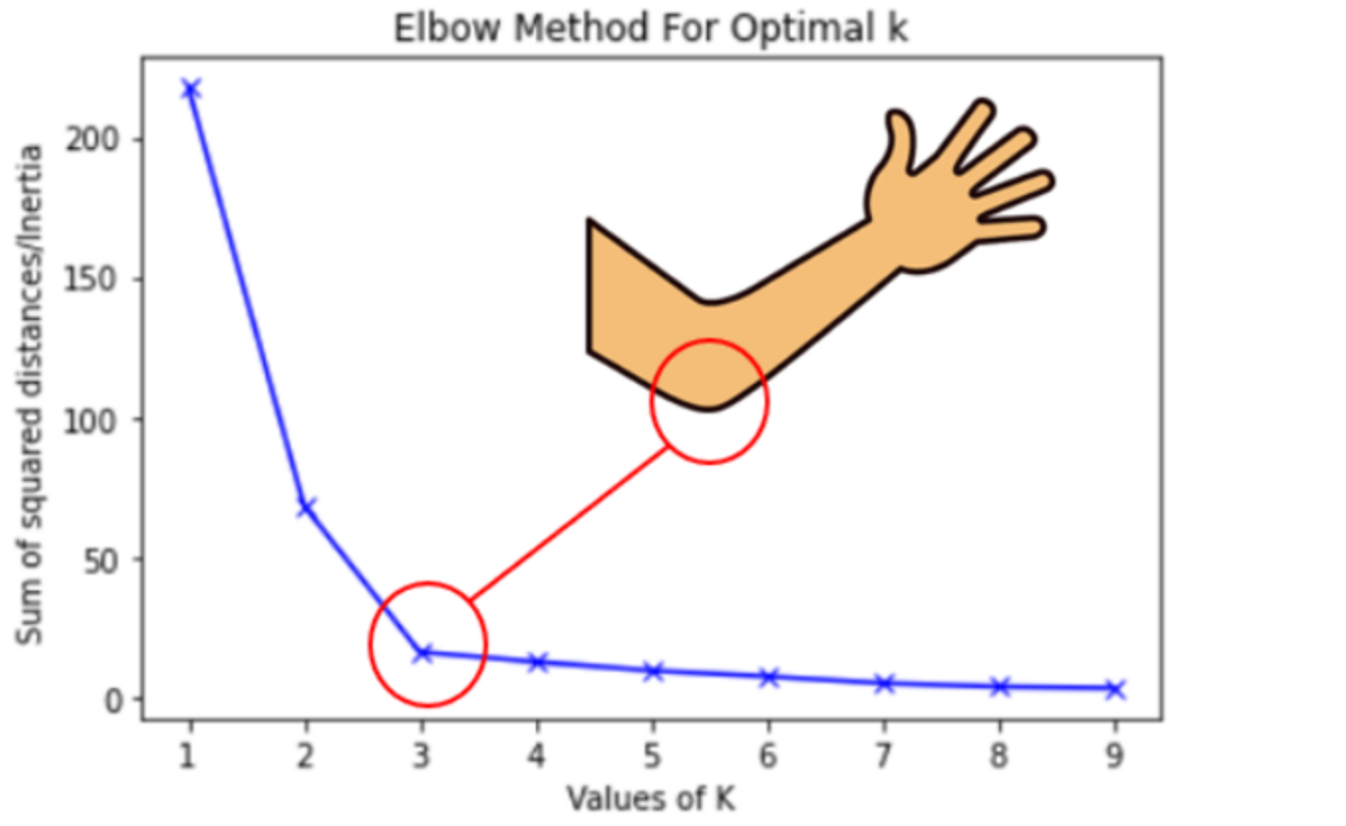
Elbow Method for optimal value of k in KMeans

Slide 39
K means algorithm
Advantages of using K means:-
The algorithm in most cases runs in linear time.
Simple and intuitive to understand
Limitations of using K means:-
A number of clusters need to be known beforehand.
It is not very robust to outliers.
Does not work very well with nonconvex shapes.
Tries to generate equal-sized clusters

Slide 40
Cluster Analysis
Finding groups of objects in data such that the objects in a group will be similar (or related) to one another and different from (or unrelated to) the objects in other groups
Inter-cluster distances are maximized
Intra-cluster distances are minimized

Slide 41
Connectivity-based Clustering (Hierarchical clustering)
Hierarchical clustering, also known as hierarchical cluster analysis, is an algorithm that groups similar objects into groups called clusters.
The endpoint is a set of clusters, where each cluster is distinct from each other cluster, and the objects within each cluster are broadly similar to each other.

Slide 42
Type of Hierarchical Clustering
Agglomerative: a bottom-up strategy
Initially each data object is in its own (atomic) cluster
Then merge these atomic clusters into larger and larger clusters
Divisive: a top-down strategy
Initially all objects are in one single cluster
Then the cluster is subdivided into smaller and smaller clusters
Clustering Ensemble
Using multiple clustering results for robustness and overcoming weaknesses of single clustering algorithms.

Slide 43
Introduction: Illustration
Illustrative Example: Agglomerative vs. Divisive
Agglomerative and divisive clustering on the data set {a, b, c, d ,e }
Step 0
Step 1
Step 2
Step 3
Step 4
Agglomerative
a
a b
b
Cluster distance
Termination condition
a b c d e
c
c d e
d
d e
e
Divisive
Step 4
Step 3
Step 2
Step 1
Step 0

Slide 44
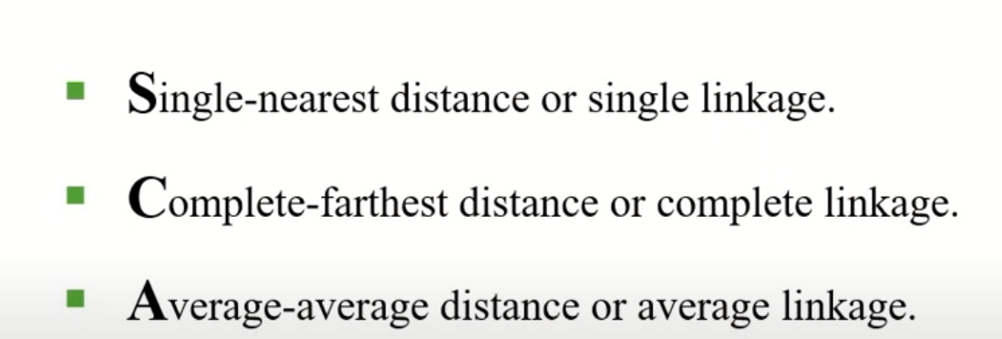
Cluster Distance Measures

Slide 45
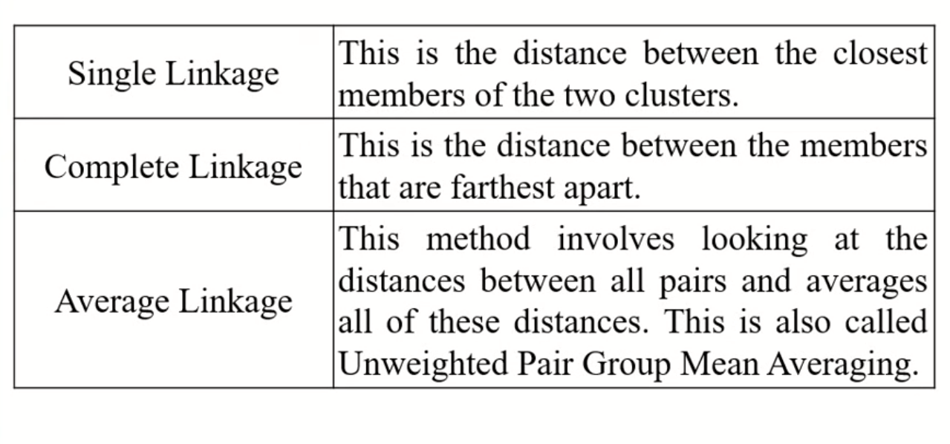
Distance Measures

Slide 46
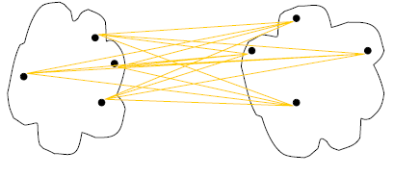
Cluster Distance Measures
Single link: smallest distance between an element in one cluster and an element in the other, i.e., d(C_{i}, C_{j}) = min{d(x_{ip}, x_{jq})}
Complete link: largest distance between an element in one cluster and an element in the other, i.e., d(C_{i}, C_{j}) = max{d(x_{ip}, x_{jq})}
Average: avg distance between elements in one cluster and elements in the other, i.e.,
d(C_{i}, C_{j}) = avg{d(x_{ip}, x_{jq})}
single link
(min)
complete link
(max)
average
d(C, C)=0
Notes:
Define D(C, C)=0, the distance between two exactly same clusters is ZERO!

Slide 47
Cluster Distance Measures
Example: Given a data set of five objects characterised by a single continuous feature, assume that there are two clusters: C1: {a, b} and C2: {c, d, e}.
1. Calculate the distance matrix. 2. Calculate three cluster distances between C1 and C2.
 | a | b | c | d | e
Feature | 1 | 2 | 4 | 5 | 6
Single link
Complete link
Average
 | a | b | c | d | e
a | 0 | 1 | 3 | 4 | 5
b | 1 | 0 | 2 | 3 | 4
c | 3 | 2 | 0 | 1 | 2
d | 4 | 3 | 1 | 0 | 1
e | 5 | 4 | 2 | 1 | 0

Slide 48
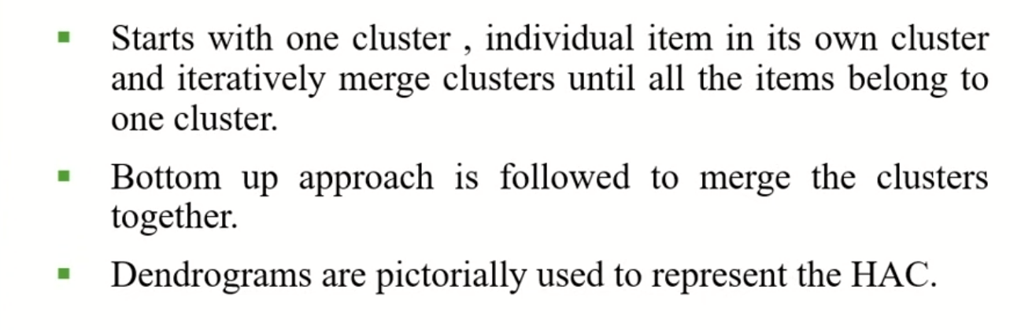
Agglomerative Algorithm

Slide 49
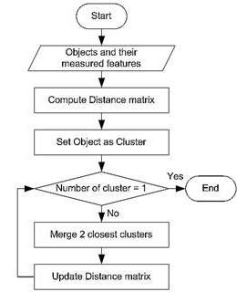
Agglomerative Algorithm
The Agglomerative algorithm is carried out in three steps:
Convert all object features into a distance matrix
Set each object as a cluster (thus if we have N objects, we will have N clusters at the beginning)
Repeat until number of cluster is one (or known # of clusters)
Merge two closest clusters
Update “distance matrix”

Slide 50
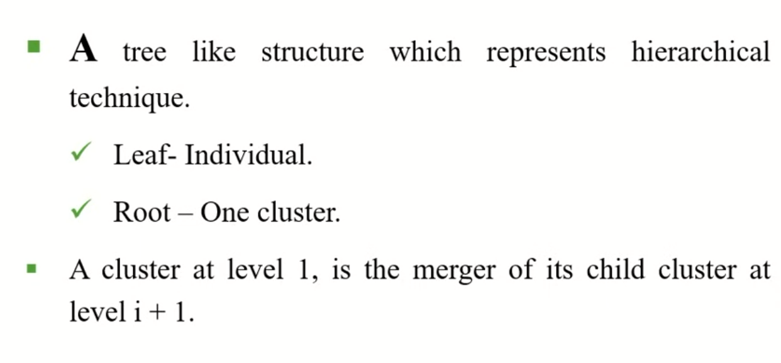
Dendrogram

Slide 51
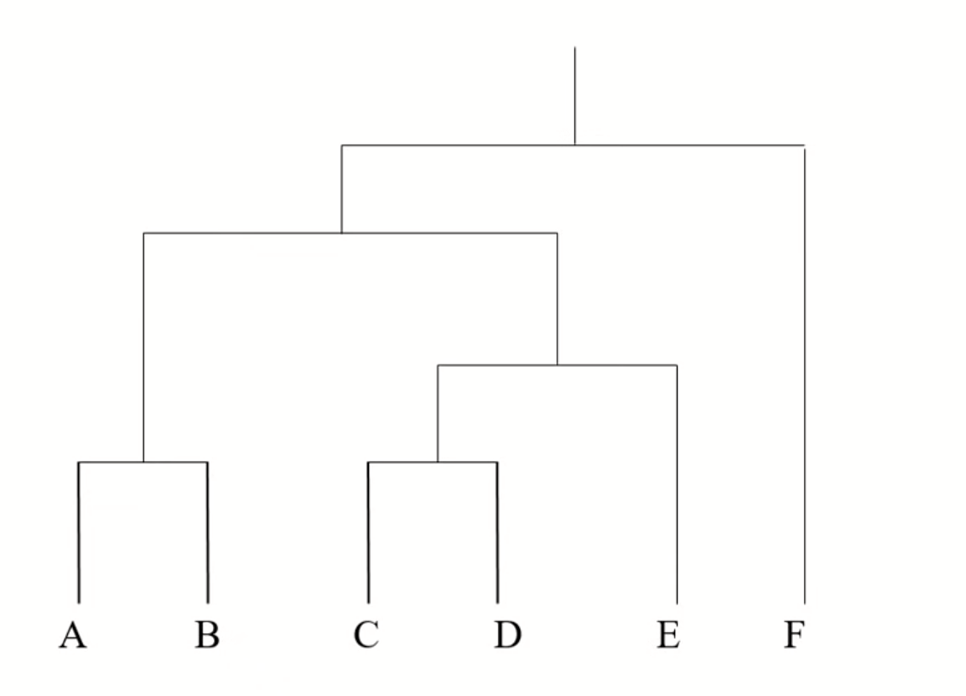
Dendrogram

Slide 52
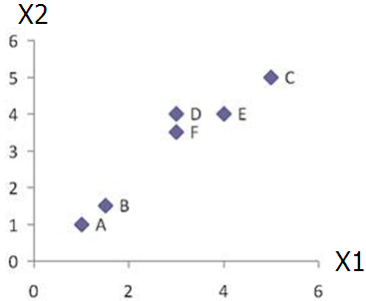
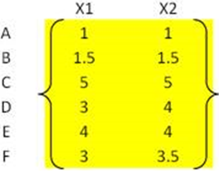
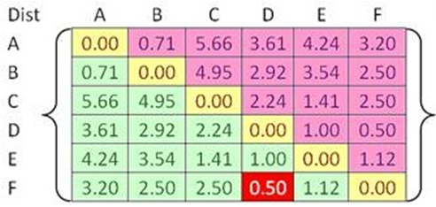
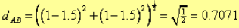
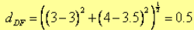
Example
Problem: clustering analysis with agglomerative algorithm
data matrix
Euclidean distance
distance matrix

Slide 53
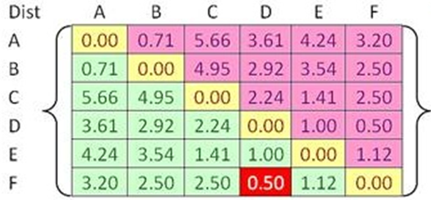
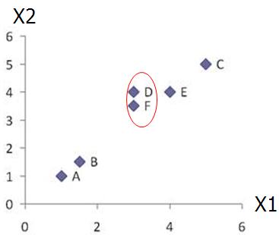
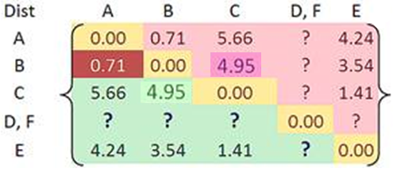
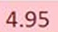
Example
Merge two closest clusters (iteration 1)

Slide 54
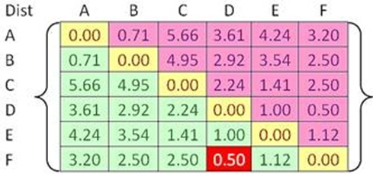
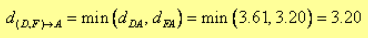
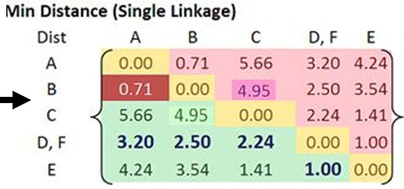
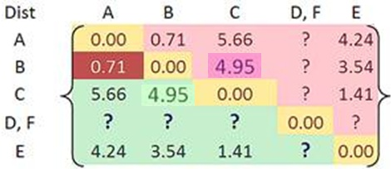
Example
Update distance matrix (iteration 1)

Slide 55
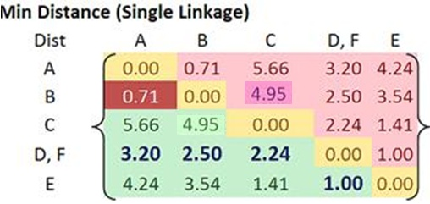
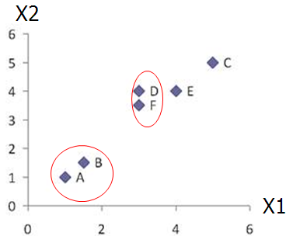
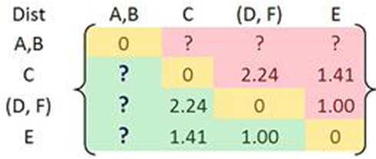
Example
Merge two closest clusters (iteration 2)

Slide 56
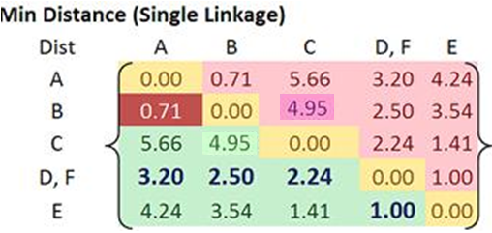
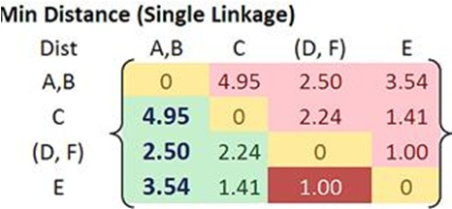

Example
Update distance matrix (iteration 2)

Slide 57
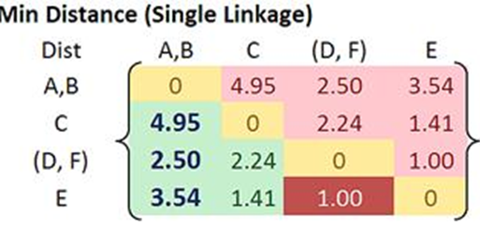
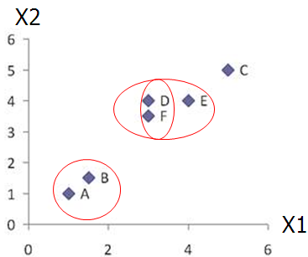
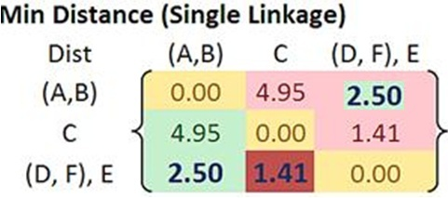
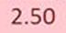
Example
Merge two closest clusters/update distance matrix (iteration 3)

Slide 58
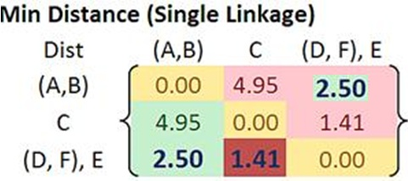
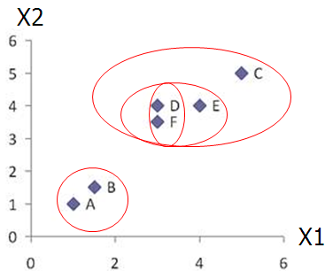


Example
Merge two closest clusters/update distance matrix (iteration 4)

Slide 59

Example
Final result (meeting termination condition)

Slide 60

Key Concepts in Hierarchal Clustering
Dendrogram tree representation
In the beginning we have 6
clusters: A, B, C, D, E and F
We merge clusters D and F into
cluster (D, F) at distance 0.50
We merge cluster A and cluster B
into (A, B) at distance 0.71
We merge clusters E and (D, F)
into ((D, F), E) at distance 1.00
We merge clusters ((D, F), E) and C
into (((D, F), E), C) at distance 1.41
We merge clusters (((D, F), E), C)
and (A, B) into ((((D, F), E), C), (A, B))
at distance 2.50
The last cluster contain all the objects,
thus conclude the computation
6
lifetime
5
4
3
2
object
Notes:
For a dendrogram tree, its horizontal axis indexes all objects in a given data set, while its vertical axis expresses the lifetime of all possible cluster formation.
The lifetime of a cluster (individual cluster) in the dendrogram is defined as a distance interval from the moment that the cluster is created to the moment that it disappears by merging with other clusters.

Slide 61
Key Concepts in Hierarchal Clustering
Lifetime vs K-cluster Lifetime
Lifetime
The distance between that a cluster is created and that it disappears (merges with other clusters during clustering).
e.g. lifetime of A, B, C, D, E and F are 0.71, 0.71, 1.41,
0.50, 1.00 and 0.50, respectively, the life time of (A, B) is
2.50 – 0.71 = 1.79, ……
K-cluster Lifetime
The distance from that K clusters emerge to that K clusters
vanish (due to the reduction to K-1 clusters).
e.g.
5-cluster lifetime is 0.71 - 0.50 = 0.21
4-cluster lifetime is 1.00 - 0.71 = 0.29
3-cluster lifetime is 1.41 – 1.00 = 0.41
2-cluster lifetime is 2.50 – 1.41 = 1.09
6
lifetime
5
4
3
2
object
Notes:
Emphasize the difference between individual cluster life time and K-cluster life time!

